Slide 1

Rubber from Rubber Tree (Hevea brasiliensis) as a Strengthening Agent for Road Reconstruction in Bangsamoro
Caday, Carlos Caesar
Diez, Nathaniel Quinn
Dimayuga, Bernice
Dona, Nicole
Lyceum of the Philippines University- Laguna

Slide 2
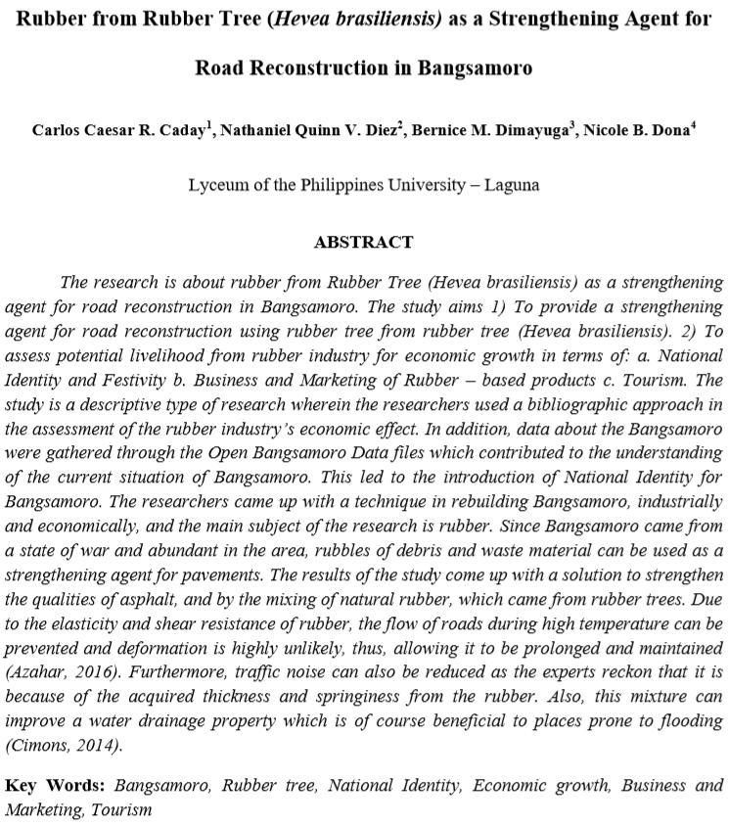

Slide 3
Introduction
Bangsamoro Organic Law (Republic Act No. 11054), also known as Bangsamoro Basic Law.
Reorganization of the region, the reconstruction of its economic, security, social, political, and infrastructures.
Conflicts still exist.
Rubber from Rubber Trees as a Strengthening Agent for Reconstruction of Road.
The South East Asia and Pacific Department, JICA, states that ARMM has a high potential of development but is affected by the long-time conflict and poverty rate.

Slide 4
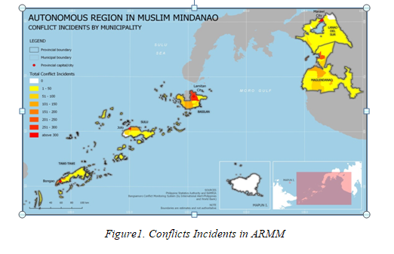
DATA

Slide 5
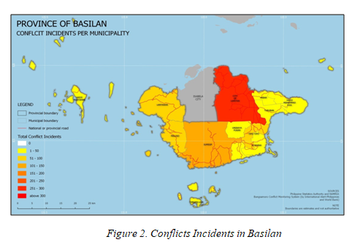

Slide 6
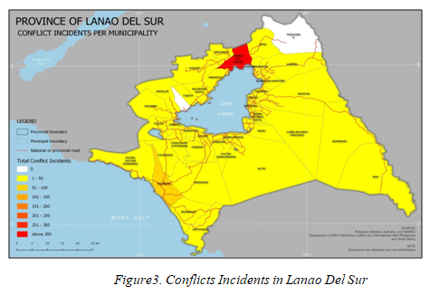

Slide 7
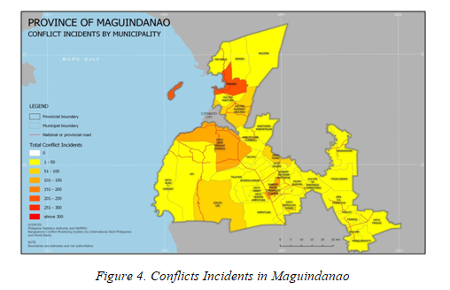

Slide 8
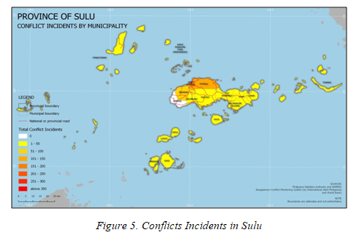

Slide 9
Objectives
To provide a strengthening agent for road reconstruction using rubber from rubber tree (Hevea brasiliensis).
To assess potential livelihood from rubber industry for economic growth in terms of:
National Identity and Festivity
Business and Marketing of Rubber – based products
Tourism

Slide 10
Methods
This study used a descriptive method of research.
The researchers used a bibliographic approach in the assessment of the rubber industry’s economic effect.
Data about the Bangsamoro were gathered through the Open Bangsamoro Data files.

Slide 11
THE PROS AND CONS OF RUBBERIZED ROAD AND RESULTS
Elasticity and shear resistance of rubber prevents deformation of roads.
Experts reckon that traffic noise can be reduced due to the thickness and springiness of rubber.
Improves water drainage properties that is beneficial to places prone to flooding.

Slide 12
REFERENCES
Photos from Open Bangsamoro drivehttps://drive.google.com/drive/folders/1W8JV4hth_
gs1V6efb92HMz0eU2LRYbOO
South East Asia Division 5 of South East Asia and Pacific Department, JICA (n.d.). EX-ANTE
EVALUATION FOR ROAD NETWORK DEVELOPMENT PROJECT IN CONFLICT
AFFECTED AREAS IN MINDANAO. Retrieved from https://www.jica.go.jp/english/
our_work/evaluation/oda_loan/economic_cooperation/c8h0vm000001r djtatt/philippines_190618_01.pdf
Azahar, N. (n.d.). AN OVERVIEW ON NATURAL RUBBER APPLICATION FOR
ASPHALT MODIFICATION. Retrieved from http://ijafp.com/wp- content/uploads/2016/03/KLIAFP2_34.pdf.
Cimons, M. (n.d.). Old tires become material for new and improved roads. Retrieved from
https://www.nsf.gov/discoveries/disc_summ.jsp?cntn_id=131175.
PHILIPPINE RUBBER INDUSTRY ROADMAP. (n.d.). Retrieved from
http://industry.gov.ph/wp-content/uploads/2015/11/Rubber-Rubber- products-Industry-Roadmap-Part-2-by-Dir.-Nestor-Arcansalin-BOI.pdf.

Slide 13

Thank you!

